Slide 1
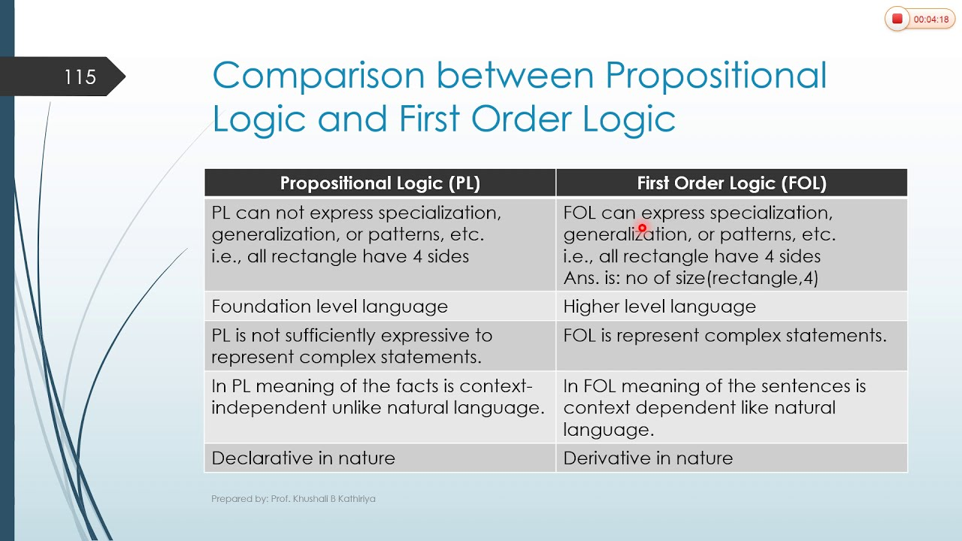
The limitation of PL is that it does not represent any individual entities whereas FOL can easily represent the individual establishment that means if you are writing a single sentence then it can be easily represented in FOL.

Slide 2
Natural Language Processing (NLP)
Natural Language?
Refers to the language spoken/written by people, e.g. English, Japanese, Bengali, as opposed to artificial languages, like C++, Java, LISP, Prolog, etc.
Natural Language Processing
Applications that deal with natural language in a way or another
Computers use (analyze, understand, generate) natural language
A somewhat applied field
Computational Linguistics
Doing linguistics on computers
More on the linguistic side than NLP, but closely related
More theoretical

Slide 3
Why NLP?
Classify text into categories
Index and search large texts
Automatic translation
Speech understanding
Understand phone conversations
Information extraction
Extract useful information from resumes
Automatic summarization
Condense 1 book into 1 page
Question answering
Knowledge acquisition
Text generations / dialogues
Applications for processing large amounts of texts
-require NLP expertise

Slide 4
NLP Involves ….
Two tasks:
Processing written text
-Lexical
-Syntactic
-Semantic
-Pragmatic
Processing spoken language,
-Lexical, Syntactic, Semantic, Pragmatic+++
- Phonology

Slide 5
NLP Involves ….
Natural Language Understanding (NLU): understanding & reasoning
while the input is NL
-Internal structure of the input NL
Natural Language Generation (NLG): generate other language
Natural Language Processing
Machine
NL Input
NL Output
Understanding
Generation

Slide 6
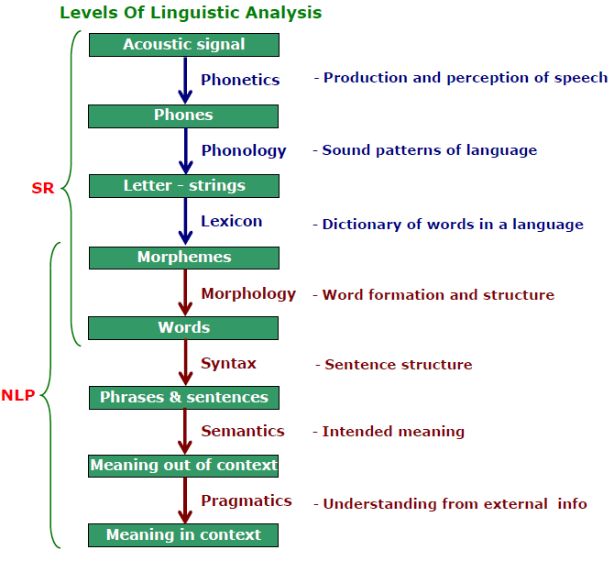
Linguistics and Language Processing
High-level
Low-level

Slide 7
Steps in the NLP
Morphological/Lexical Analysis: Individual words are analyzed into their components
-non-word tokens such as punctuation are separated from the words.
-Divide the text into paragraphs, sentences & words
Syntactic Analysis: Linear sequences of words are transformed into structures that show how the words relate to each other.
-Boy the go to store (rejected due to violate the rules)

Slide 9
Steps in the NLP
Semantic Analysis: The structures created by the syntactic analyzer are assigned meanings.
-Manush gass khai (syntactically correct but semantically not)
Discourse integration: The meaning of an individual sentence may depend on the sentences that precede it and may influence the meanings of the sentences that follow it.
-you wanted it (it depends on the prior discourse context)
Pragmatic Analysis: The structure representing what was said is reinterpreted to determine what was actually meant.
-commonsense knowledge
-Do you know what is it? (request)

Slide 10
Morphological Analysis
Morphology is the analysis of words into morphemes & conversely the synthesis of words from morphemes
Morphemes
-a smallest meaningful unit in the grammar
-a smallest linguistic unit that has semantic meaning
-a unit of language immediately below the ‘word level’
-a smallest part of a word that can carry a discrete meaning

Slide 11
Morphological Analysis
Example:
The word “unbreakable” has 03 morphemes
un- a bound morpheme
-break- a free morpheme
-able- a bound morpheme
Also, un: prefix, able-suffix--affixes
How many morphemes?
“aagniporikhha” “unreliable”,

Slide 12
Types of Morphemes
Free Morphemes:
-can appear stand alone/free
town, dog
-with other lexemes
town hall, dog house
Bound Morphemes
-appear only together with other morphemes to form a lexeme
un-: may be prefix/suffix
Inflectional Morphemes
-modify a word’s tense, number, aspects etc
dog morpheme with plural marker
morpheme s becomes dogs

Slide 13
Syntactic Analysis
Syntax
-Syntax is the structure of language.
-It is the grammatical arrangement of the words in a sentence to show its relationship to one another in a sentence
-Syntax is a finite set of rules that specify a language
-Rules: Phase Structure Rules
Context-Free or Context-Sensitive
-Syntax rules govern proper sentence structure
-Syntax is represented by Parse tree:
-a way to show the structure of a language
fragment or by a list

Slide 14
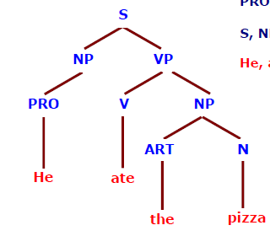
Syntactic Analysis
He ate the pizza
PS Rules
S→ NP VP
NP → PRO
NP → ART N
VP → V NP
Input String
Parser
Lexicon
V-ate
PRO-he
N-pizza
ART-the
Parse Tree

Slide 15
PS Rules
S→ NP VP
NP → (Det) (ADJS) N
NP → PRO
NP →PN
ADJS → ADJ |ADJS
VP → V (NP)
N → file|printer
PN → Bill|Rahim|Bird
PRO → I|he|she
Det → the|a|an
ADJ → short|long|want|red
V → printed|created|want
Bill printed the red file
S
NP VP
PN
V NP
Bill
printed
Det ADJS N
the
ADJ
file
red

Slide 16
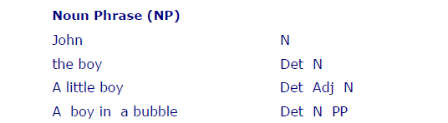
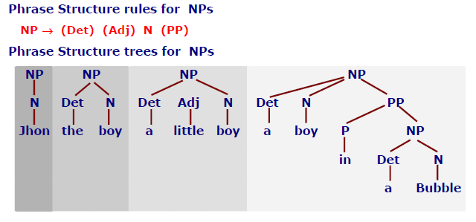
PS Rules and Tress for NP

Slide 17
Parser
A parser is a program, that accepts as input a sequence of words in a natural language and breaks them up into parts (nouns, verbs, & their attributes), to be managed by other programming.The output of a parser is a parse tree/Structural Representation (SR)
Parsing can be defined as the act of analyzing the grammatically an utterance according to some specific grammar
Parsing is the process to check, that a particular sequence of words in sentence correspond to a language defined by its grammar
Parsing means show how we can get from the start symbol of the grammar to the sentence of words using the production rules

Slide 18
Properties of a Parse Tree
Parse tree is a way of representing the output of a parser
Each phrasal constituent found during parsing becomes a branch node of the parse tree
Every node corresponds either to an input word or to a non-terminal
Each level in the parse tree corresponds to the application of one PS rule
The words of the sentence become the leaves of the parse tree
There can be more than one parse tree for a single sentence

